Slide 1
Cycloid Reducer
周奕彬

Slide 2
大綱
不同種減速機形式
等效連桿-曲率半徑
未來目標

Slide 3
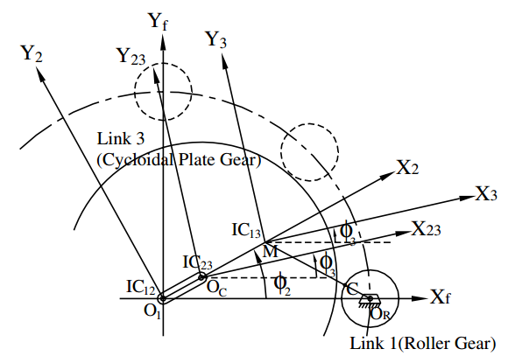
Stationary ring gear type epicycloid reducer

Slide 4
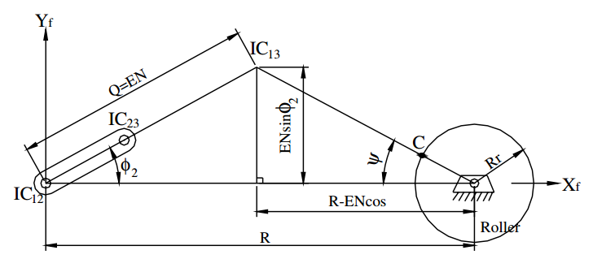

Slide 5
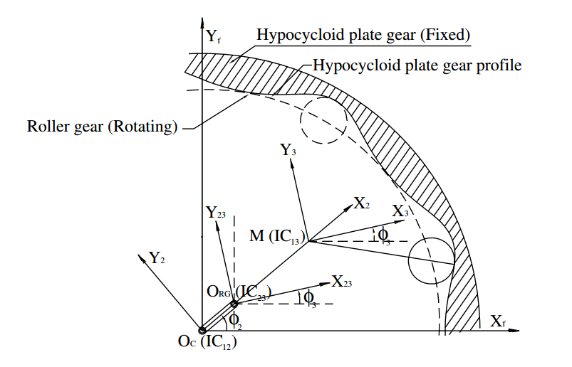

Slide 6
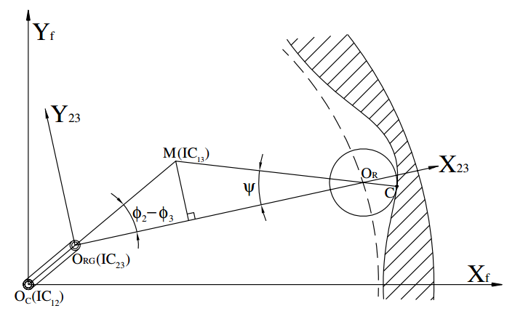
Stationary ring gear type hypocycloid reducer

Slide 7
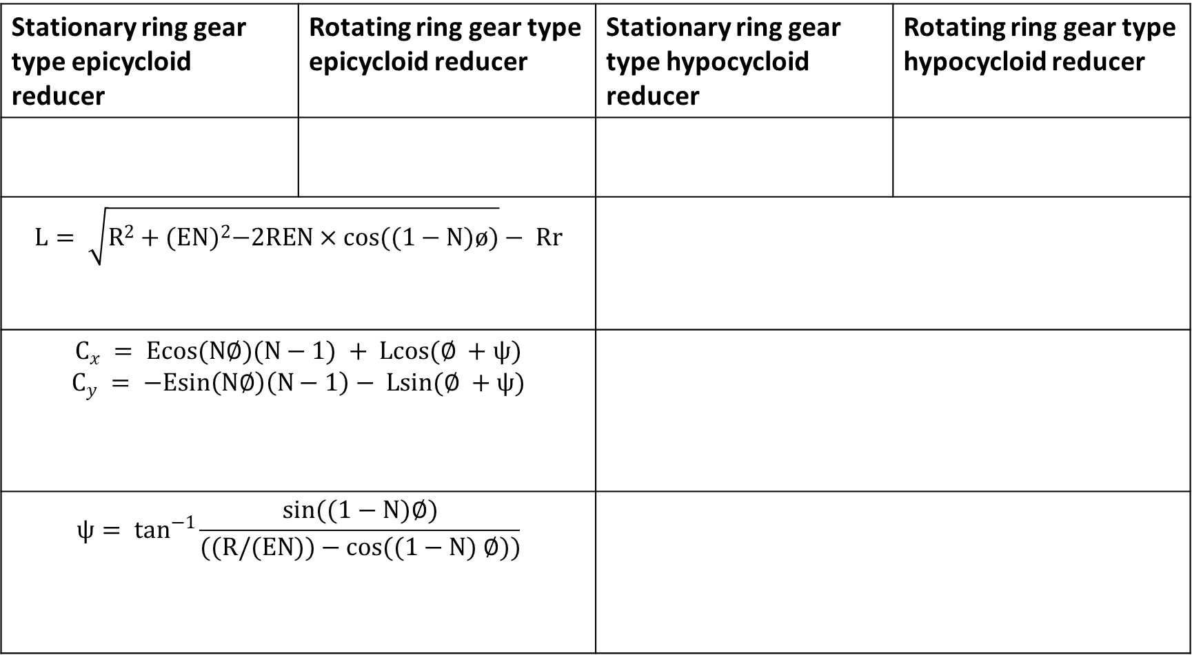
Stationary ring gear type epicycloid reducer | Rotating ring gear type epicycloid reducer | Stationary ring gear type hypocycloid reducer | Rotating ring gear type hypocycloid reducer
$$L= \sqrt{R^{2}+{(EN)}^{2}−2REN×cos((1−N)ø)}− Rr$$
$$C_{x} = Ecos(N∅)(N−1) + Lcos(∅ +ψ)$$ $$C_{y} = −Esin\left(N∅\right)\left(N−1\right)− Lsin(∅ +ψ)$$
$$ψ= \tan^{−1}{\frac{sin((1−N)∅)}{((R/(EN))−cos((1−N) ∅))}}$$

Slide 8
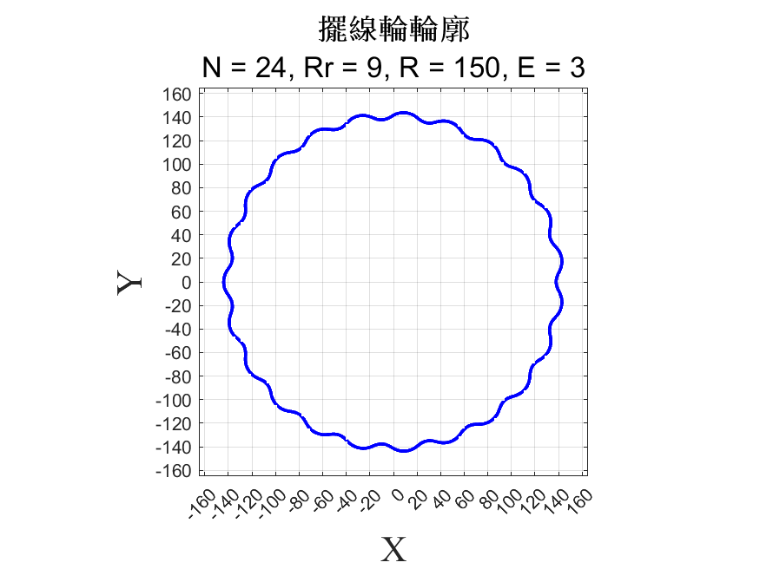
曲率半徑

Slide 9
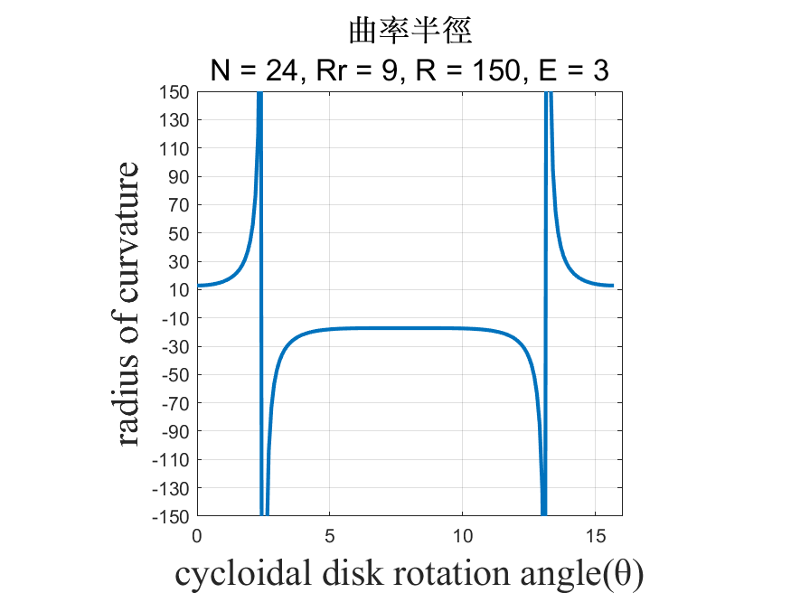
曲率半徑

Slide 11
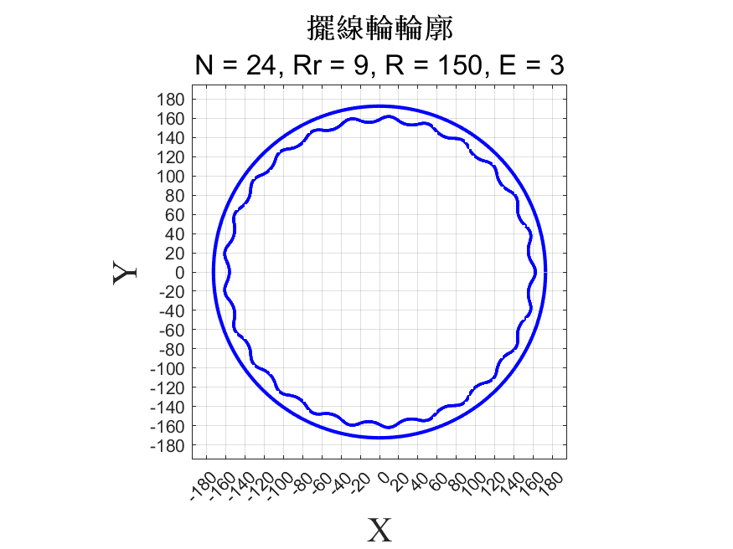
曲率半徑

Slide 12
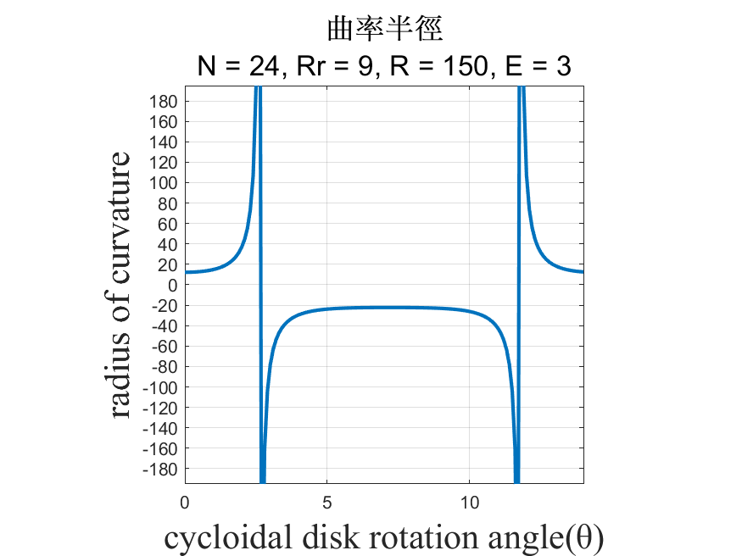
曲率半徑

Slide 14
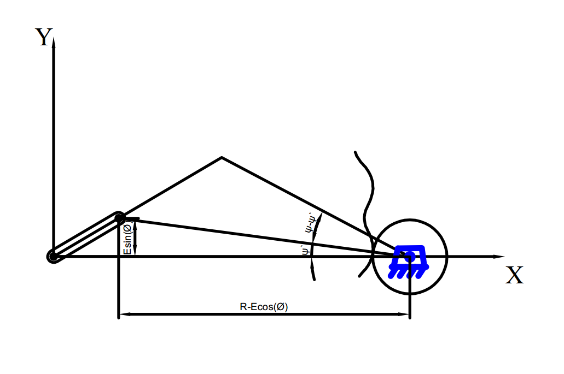

Slide 15
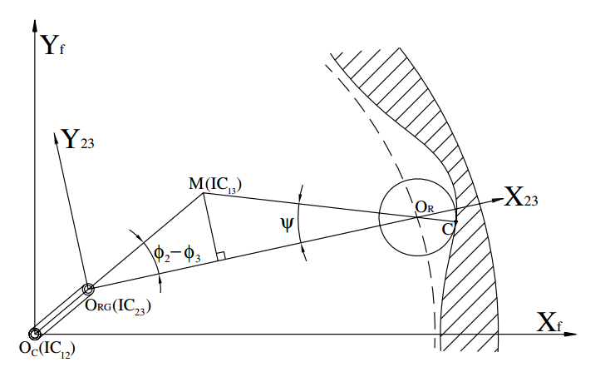

Slide 16
未來目標
尋找在曲率半徑極大下的解決辦法
以等效連桿組分析機械誤差

